Slide 1



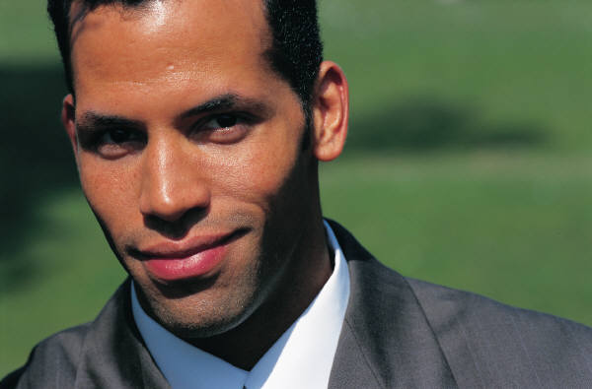
Choosing a Form of Ownership
Copyright ©2009 Pearson Education, Inc. Publishing as Prentice Hall
Notes:
This "Deco" border was drawn on the Slide master using PowerPoint's Rectangle and Line tools. A smaller version was placed on the Notes Master by selecting all of the elements (using Select All from the Edit menu), deselecting the unwanted elements such as the Title (holding down the Shift key and clicking on the unwanted elements), and then using Paste as Picture from the Edit menu to place the border on the Notes Master. After pasting as a picture, we used the resize handles (with Shift to maintain the proportions) to reduce it to the size you see.
Be sure to delete this word processing box before using this template for your own presentation.

Slide 2

Choosing a Form of Ownership
There is no one “best” form of ownership
The best form of ownership depends on an entrepreneur’s particular situation
The key to choosing a form of ownership is understanding how each form’s characteristics affect an entrepreneur’s specific business and personal circumstances
Copyright © 2009 Pearson Education, Inc. Publishing as Prentice Hall

Slide 3

Factors to Consider
Tax considerations
Liability exposure
Start-up capital requirements
Control
Managerial ability
Business goals
Management succession plans
Cost of formation
Copyright ©2009 Pearson Education, Inc. Publishing as Prentice Hall

Slide 4

Forms of Ownership
Sole Proprietorship
Partnership
Corporation
S Corporation
Limited Liability Company
Joint Venture
Copyright ©2009 Pearson Education, Inc. Publishing as Prentice Hall

Slide 5
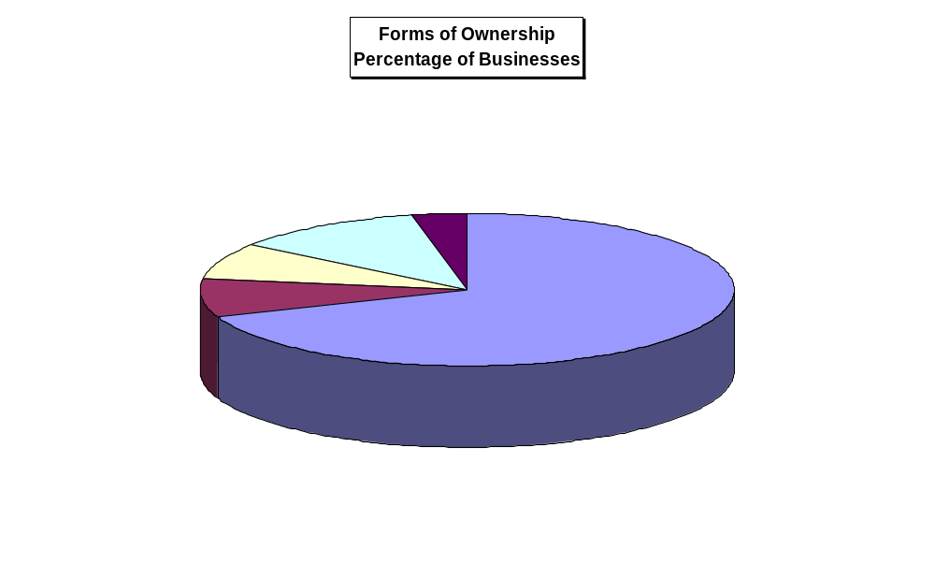
Data Source: Statistics of Income Bulletin, Internal Revenue Service, October, 2006

Slide 6
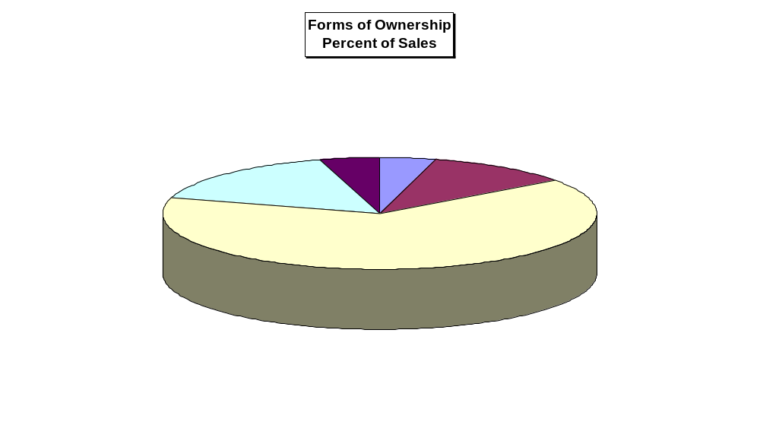
Data Source: Statistics of Income Bulletin, Internal Revenue Service, October, 2006

Slide 7
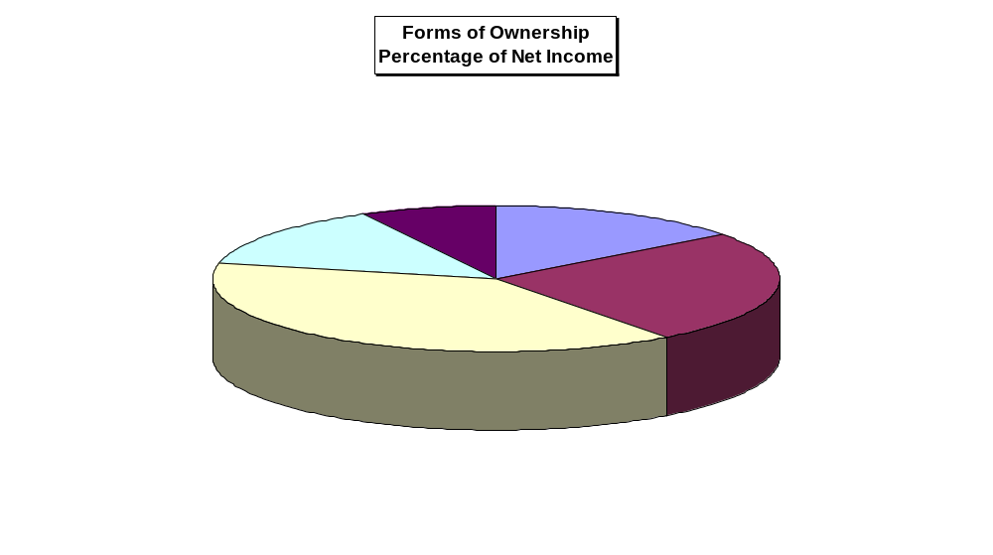
Data Source: Statistics of Income Bulletin, Internal Revenue Service, October, 2006

Slide 8

Advantages of the Sole Proprietorship
Simple to create
Least costly form to begin
Profit incentive
Total decision-making authority
No special legal restrictions
Easy to discontinue
Copyright ©2009 Pearson Education, Inc. Publishing as Prentice Hall

Slide 9

Disadvantages of the Sole Proprietorship
Unlimited personal liability
Copyright ©2009 Pearson Education, Inc. Publishing as Prentice Hall

Slide 10
Liability Features of the Basic Forms of Ownership
Sole Proprietorship
Claims of Sole Proprietor’s Creditors
Sole Proprietor’s Personal Assets
Copyright © 2009 Pearson Education, Inc. Publishing as Prentice Hall

Slide 11
Disadvantages of the Sole Proprietorship
Unlimited personal liability
Limited access to capital
Limited skills and abilities
Feelings of isolation
Lack of continuity
Copyright ©2009 Pearson Education, Inc. Publishing as Prentice Hall

Slide 12

Partnership
An association of two or more people who co-own a business for the purpose of making a profit
Take the time to create a written partnership agreement!
Copyright ©2009 Pearson Education, Inc. Publishing as Prentice Hall

Slide 13

Advantages of the Partnership
Easy to establish
Complementary skills of partners
Division of profits
Larger pool of capital
Copyright ©2009 Pearson Education, Inc. Publishing as Prentice Hall

Slide 14

Advantages of the Partnership
Ability to attract limited partners
Minimal government regulation
Flexibility
Taxation
Copyright ©2009 Pearson Education, Inc. Publishing as Prentice Hall

Slide 15
Disadvantages of the Partnership
Unlimited liability of at least one partner
Copyright ©2009 Pearson Education, Inc. Publishing as Prentice Hall

Slide 16
Types of Partners
General partners
  Take an active role in managing a business
  Have unlimited liability for the partnership’s debts
  Every partnership must have at least one general partner
Limited partners
  Cannot participate in the day-to-day management of a company
  Have limited liability for the partnership’s debts
Copyright ©2009 Pearson Education, Inc. Publishing as Prentice Hall

Slide 17
Liability Features of the Basic Forms of Ownership
Partnership
Claims of Partnership’s Creditors
General
Partner’s
Personal
Assets
General
Partner’s
Personal
Assets
Partnership’s Assets
Copyright © 2009 Pearson Education, Inc. Publishing as Prentice Hall

Slide 18
Disadvantages of the Partnership
Unlimited liability of at least one partner
Capital accumulation
Difficulty in disposing of partnership interest
Copyright ©2009 Pearson Education, Inc. Publishing as Prentice Hall

Slide 19

Disadvantages of the Partnership
Lack of continuity
Potential for personality and authority conflicts
Partners bound by the law of agency
Copyright ©2009 Pearson Education, Inc. Publishing as Prentice Hall

Slide 20
Limited Partnership
A partnership composed of at least one general partner and one or more limited partners
The general partner in a limited partnership is treated exactly as in a general partnership
The limited partner has limited liability and is treated as an investor in the business
Copyright ©2009 Pearson Education, Inc. Publishing as Prentice Hall

Slide 21
Liability Features of the Basic Forms of Ownership
Limited Partnership
Claims of Partnership’s Creditors
Barrier
Partnership’s Assets
General
Partner’s
Personal
Assets
Limited
Partner’s
Personal
Assets
Copyright © 2009 Pearson Education, Inc. Publishing as Prentice Hall

Slide 22
The Corporation
A separate legal entity from its owners
Types of corporations:
  Domestic - a corporation doing business in the state in which it is incorporated
  Foreign - a corporation chartered in one state and doing business in another state
  Alien - a corporation formed in another country but doing business in the United States
Copyright ©2009 Pearson Education, Inc. Publishing as Prentice Hall

Slide 23
The Corporation
Types of corporations:
  Publicly held - a corporation that has a large number of shareholders and whose stock usually is traded on one of the large stock exchanges
  Closely held - a corporation in which shares are controlled by a relatively small number of people, often family members, relatives, or friends
Copyright ©2009 Pearson Education, Inc. Publishing as Prentice Hall

Slide 24

Advantages of the
Corporation
Limited liability of the stockholders
Copyright ©2009 Pearson Education, Inc. Publishing as Prentice Hall

Slide 25
Liability Features of the Basic Forms of Ownership
Corporation
Claims of Corporation’s Creditors
Barrier
Barrier
Corporation’s Assets
Shareholder’s
Personal Assets
Shareholder’s
Personal Assets
Copyright © 2009 Pearson Education, Inc. Publishing as Prentice Hall

Slide 26
Advantages of the
Corporation
Limited liability of stockholders
Ability to attract capital
Ability to continue indefinitely
Transferable ownership
Copyright ©2009 Pearson Education, Inc. Publishing as Prentice Hall

Slide 27

Disadvantages of the Corporation
Cost and time of incorporating
“Double taxation”
Potential for diminished managerial incentives
Copyright ©2009 Pearson Education, Inc. Publishing as Prentice Hall

Slide 28

Disadvantages of the Corporation
Legal requirements and regulatory “red tape”
Potential loss of control by founder(s)
Piercing the corporate veil
Copyright ©2009 Pearson Education, Inc. Publishing as Prentice Hall

Slide 29
S Corporation
No different from any other corporation from a legal perspective
For tax purposes, however, an S corporation is taxed like a partnership, passing all of its profits (or losses) through to the individual shareholders
To elect “S” status, all shareholders must consent, and the corporation must file with the IRS within the first 75 days of its tax year
Copyright ©2009 Pearson Education, Inc. Publishing as Prentice Hall

Slide 30
Liability Features of the Basic Forms of Ownership
S-Corporation
Claims of S-Corporation’s Creditors
Barrier
Barrier
S-Corporation’s Assets
Shareholder’s
Personal Assets
Shareholder’s
Personal Assets
Copyright © 2009 Pearson Education, Inc. Publishing as Prentice Hall

Slide 31
S Corporation
Must be a U.S.-based corporation
No nonresident alien shareholders
Only one class of common stock
No more than 100 shareholders (increased from 75)
No more than 20% of corporate income from passive investment sources
Corporations and partnerships cannot be shareholders
Copyright ©2009 Pearson Education, Inc. Publishing as Prentice Hall

Slide 32

Limited Liability Company (LLC)
Resembles an S Corporation but is not subject to the same restrictions
Two documents:
  Articles of organization
  Operating agreement
Copyright ©2009 Pearson Education, Inc. Publishing as Prentice Hall

Slide 33
Limited Liability Company (LLC)
An LLC cannot have more than two of these four corporate characteristics:
  Limited liability
  Continuity of life
  Free transferability of interest
  Centralized management
Copyright ©2009 Pearson Education, Inc. Publishing as Prentice Hall

Slide 34
Liability Features of the Basic Forms of Ownership
Limited Liability Company (LLC)
Claims of LLC’s Creditors
Barrier
Barrier
LLC’s Assets
Member’s
Personal Assets
Member’s
Personal Assets
Copyright © 2009 Pearson Education, Inc. Publishing as Prentice Hall

Slide 35

All rights reserved. No part of this publication may be reproduced, stored in a retrieval system, or transmitted, in any form or by any means, electronic, mechanical, photocopying, recording, or otherwise, without the prior written permission of the publisher. Printed in the United States of America.
Copyright ©2009 Pearson Education, Inc. Publishing as Prentice Hall
Copyright ©2009 Pearson Education, Inc. Publishing as Prentice Hall

